Slide 1
Graph Metrics and Data Generation Models lecture-2 Course on Graph Neural Networks (Summer Term 22)
Prof. Dr. Holger Giese (holger.giese@hpi.uni-potsdam.de)
Christian Medeiros Adriano (christian.adriano@hpi.de) - “Chris”
Matthias Barkowsky (matthias.barkowsky@hpi.de )
Iqra Zafar (iqra.zafar@hpi.de)

Slide 2
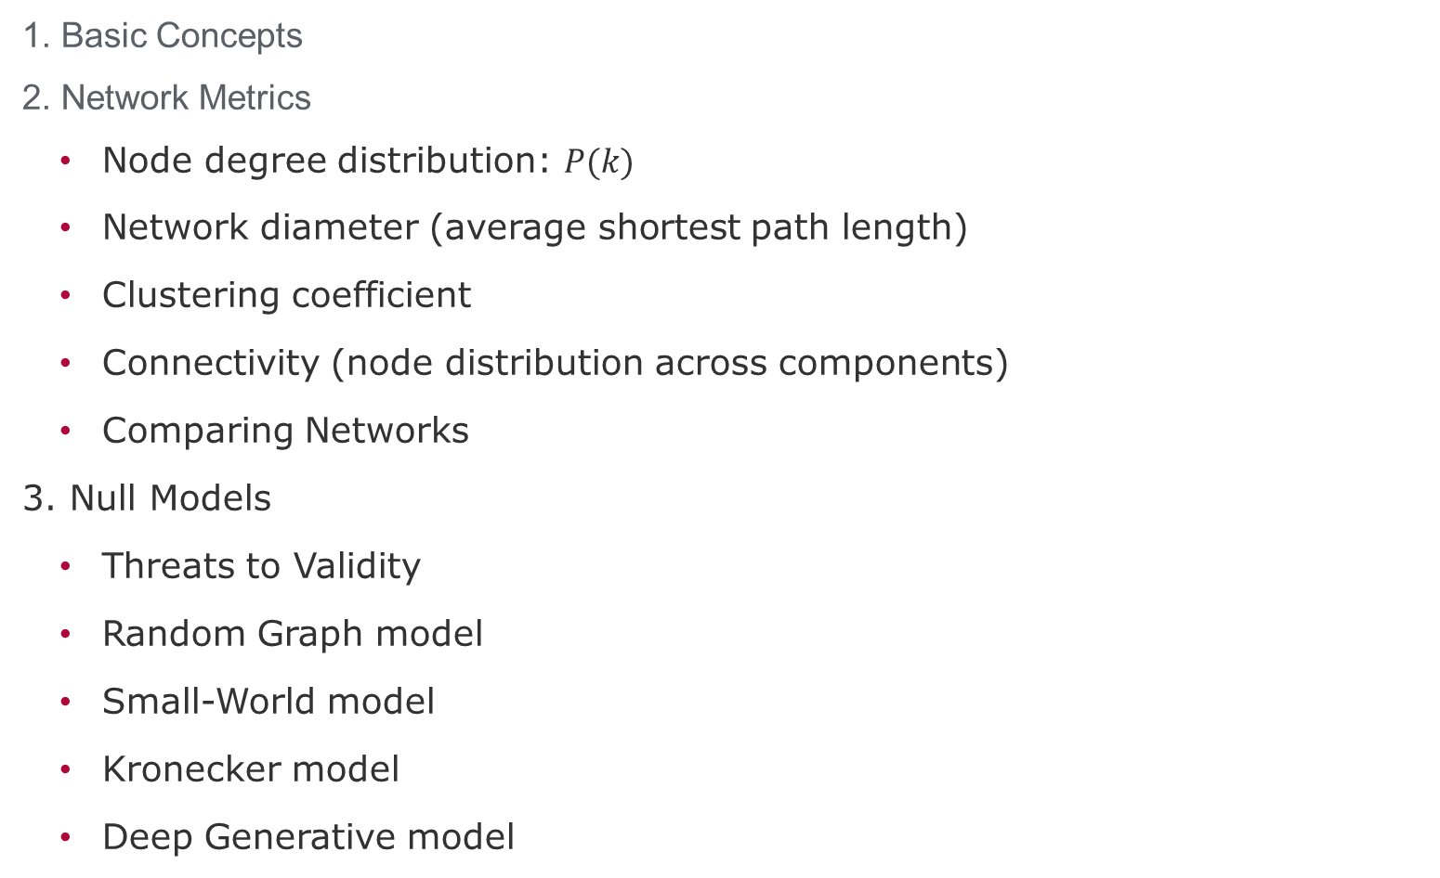
Lecture topics
1. Basic Concepts
2. Network Metrics
Node degree distribution: $P(k)$
Network diameter (average shortest path length)
Clustering coefficient
Connectivity (node distribution across components)
Comparing Networks
3. Null Models
Threats to Validity
Random Graph model
Small-World model
Kronecker model
Deep Generative model

Slide 3
Basic Concepts

Slide 4
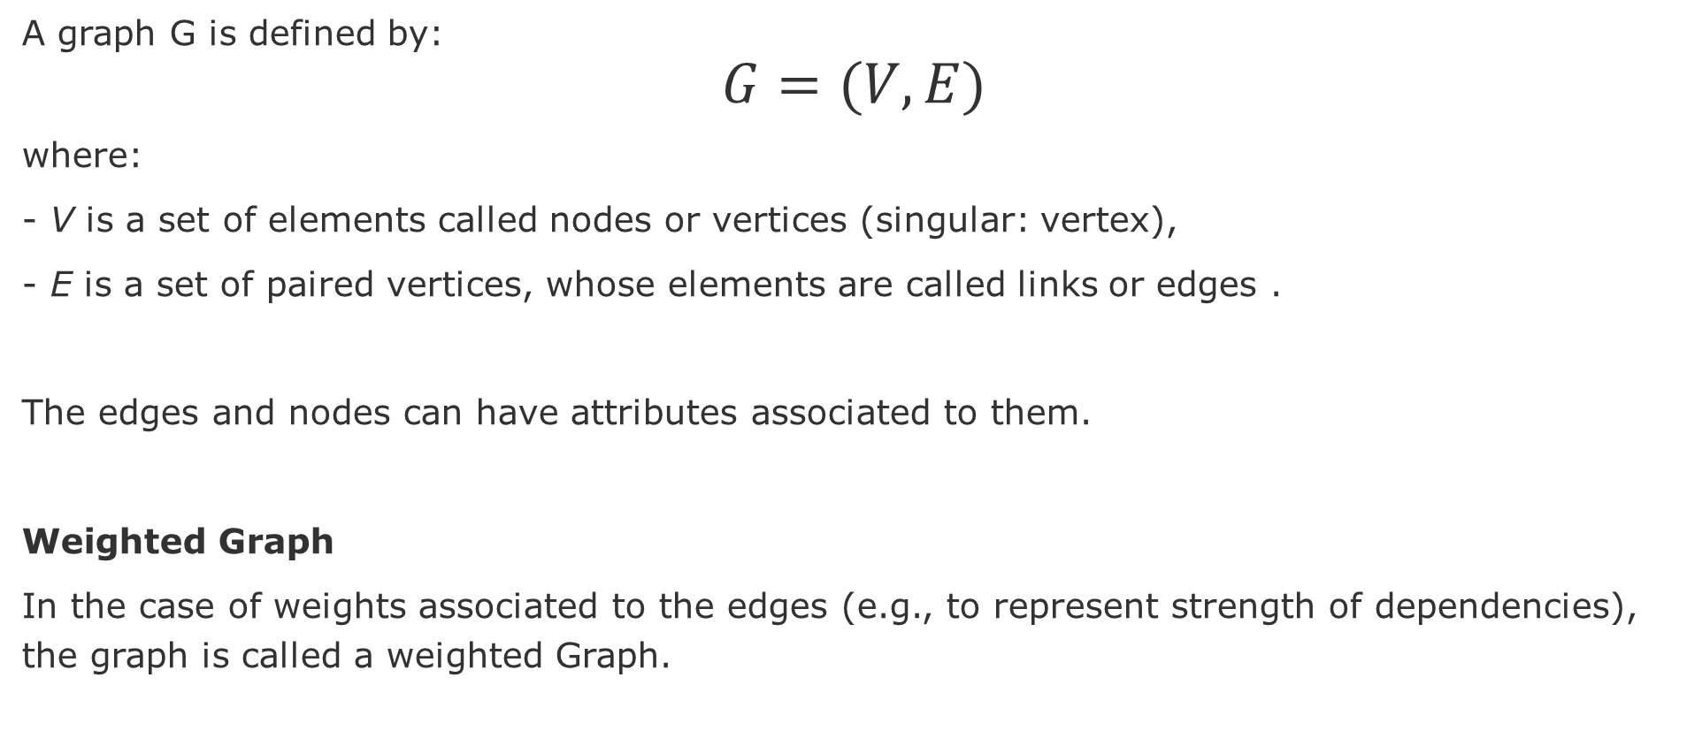
Graph Definition
A graph G is defined by:
$$G=(V,E)$$
where:
- V is a set of elements called nodes or vertices (singular: vertex),
- E is a set of paired vertices, whose elements are called links or edges .
The edges and nodes can have attributes associated to them.
Weighted Graph
In the case of weights associated to the edges (e.g., to represent strength of dependencies), the graph is called a weighted Graph.

Slide 5
Types of graphs
Directed
Undirected
Disconnected
Fully connected
A
A
A
A
B
B
B
B
C
C
C
C
D
D
D
D
Directed Acyclic Graph
(DAG)
Multigraph
Bipartite
Cliques
E
A
A
A
A
B
B
B
F
B
C
C
C
D
D
D
C
D
Ego network of A

Slide 6
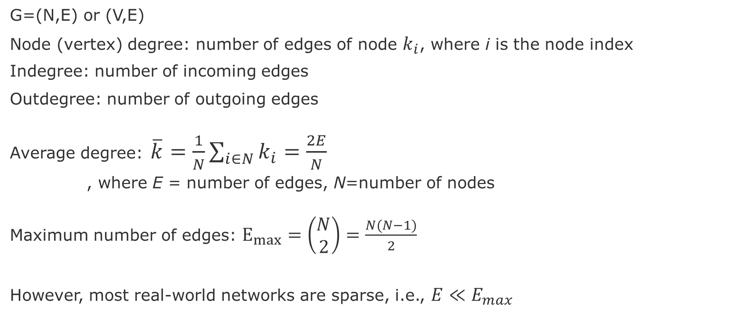
Node and Edge degrees
G=(N,E) or (V,E)
Node (vertex) degree: number of edges of node $k_{i}$, where i is the node index
Indegree: number of incoming edges
Outdegree: number of outgoing edges
Average degree: $\overline{k}=\frac{1}{N}\sum_{i∈N}{k_{i}}=\frac{2E}{N}$
, where E = number of edges, N=number of nodes
Maximum number of edges: $E_{max}=\left(\begin{aligned}N \\ 2\end{aligned}\right)=\frac{N(N−1)}{2}$
However, most real-world networks are sparse, i.e., $E≪E_{max}$
Notes:
Leskovec, Jure, et al. "Community structure in large networks: Natural cluster sizes and the absence of large well-defined clusters." Internet Mathematics 6.1 (2009): 29-123.

Slide 7
Adjacency matrix
 | A | C | D | B | E | F
A | 1 | 1 | 1 | 1 | 0 | 0
C | 1 | 0 | 1 | 1 | 0 | 0
D | 1 | 1 | 0 | 1 | 0 | 0
B | 1 | 1 | 1 | 0 | 1 | 1
E | 0 | 0 | 0 | 1 | 0 | 1
F | 0 | 0 | 0 | 1 | 1 | 0
Cliques
E
A
F
B
C
D
However, adjacency matrix of real-world networks are full of zeros

Slide 8
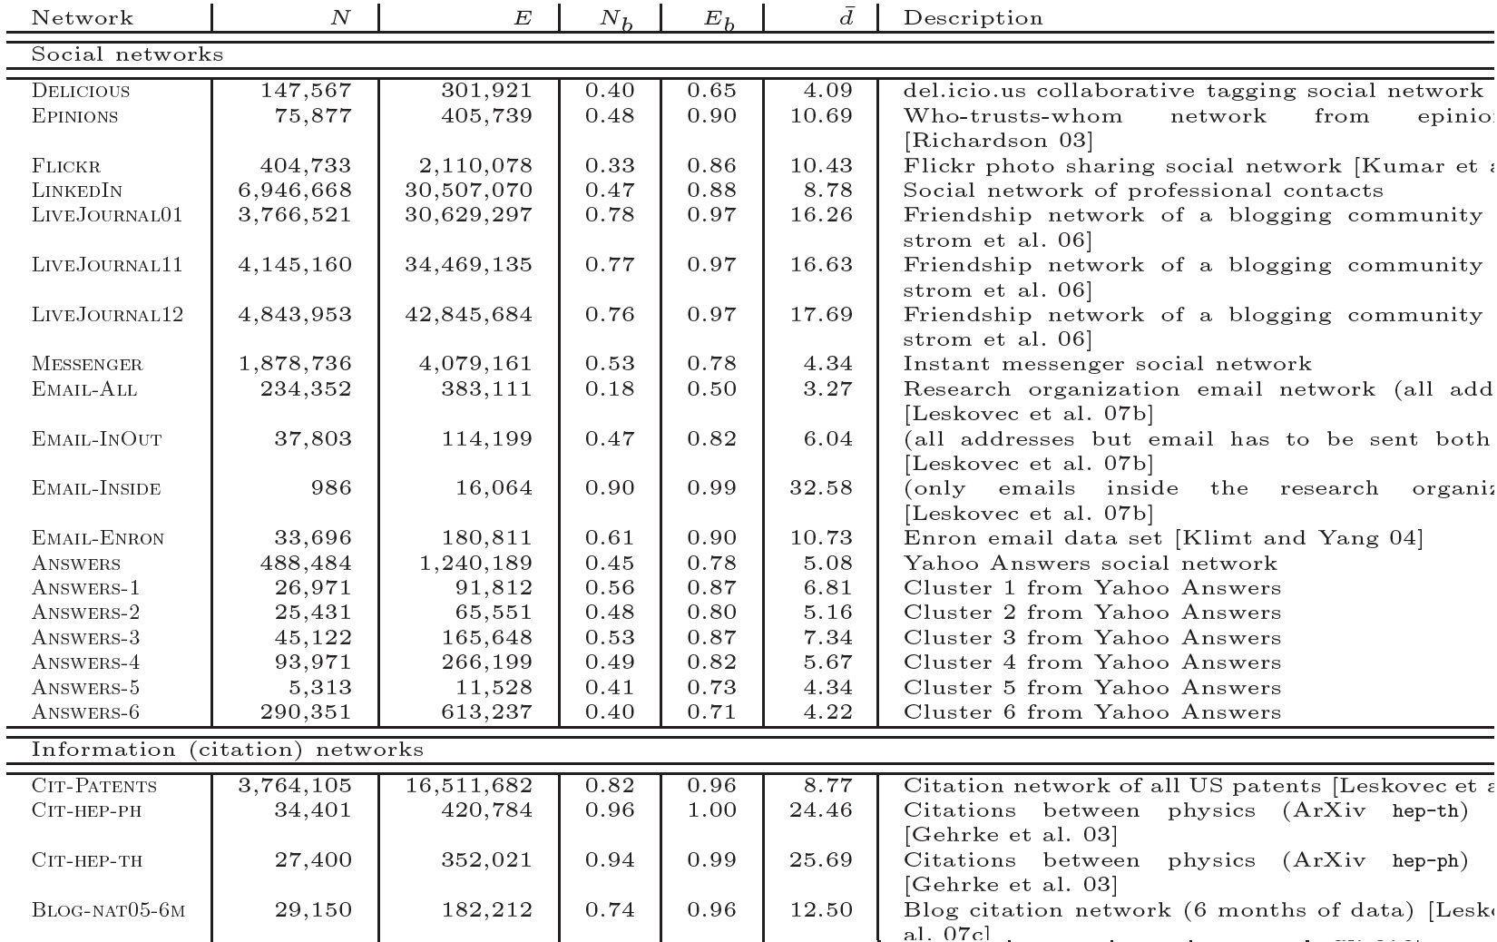
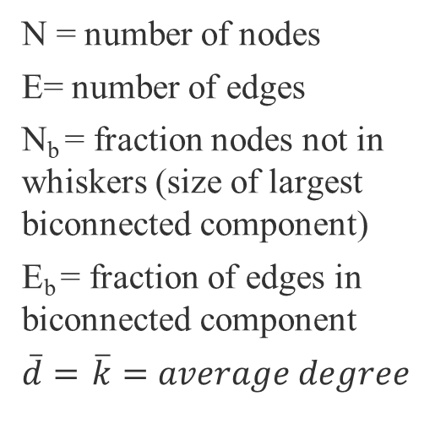
Most real-world networks are sparse
N = number of nodes
E= number of edges
N_{b} = fraction nodes not in whiskers (size of largest biconnected component)
E_{b} = fraction of edges in biconnected component
$\overline{d}=$ $\overline{k}=average degree$
source :Leskovec, J., et al. "Community structure in large networks: Natural cluster sizes and the absence of large well-defined clusters." Internet Mathematics 6.1 (2009): 29-123.

Slide 9
Network Metrics

Slide 10
Node Degree Distribution $P\left(k\right)=N_{k}/N$
A
2
B
4
C
D
3
2
 | A | C | D | B | E | F | ∑
A | 1 | 1 | 1 | 1 | 0 | 0 | 4
C | 1 | 0 | 1 | 1 | 0 | 0 | 3
D | 1 | 1 | 0 | 1 | 0 | 0 | 3
B | 1 | 1 | 1 | 0 | 1 | 1 | 5
E | 0 | 0 | 0 | 1 | 0 | 1 | 2
F | 0 | 0 | 0 | 1 | 1 | 0 | 2
E
A
F
B
C
D

Slide 11
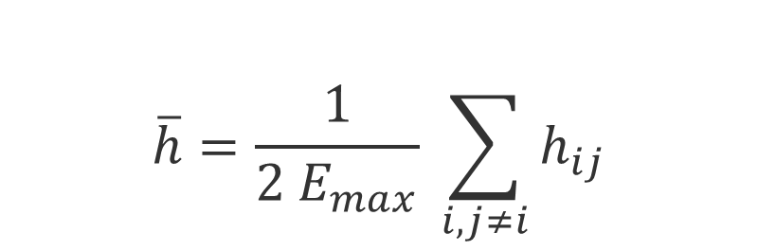
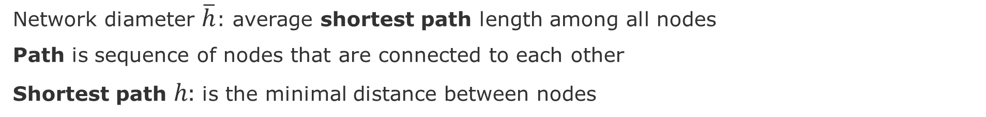
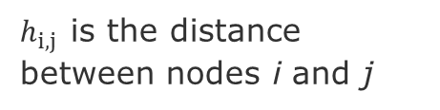
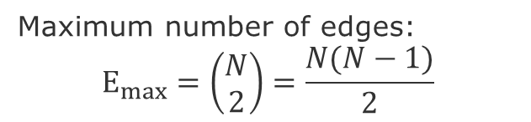
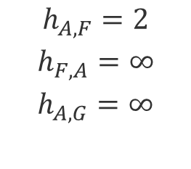
Network Diameter (or geodesic distance)
Network diameter $\overline{h}$: average shortest path length among all nodes
Path is sequence of nodes that are connected to each other
Shortest path $h:$ is the minimal distance between nodes
E
$$\overline{h}=\frac{1}{2 E_{max}} \sum_{i,j≠i}{h_{ij}}$$
A
F
B
H
C
G
D
Maximum number of edges:
$$E_{max}=\left(\begin{aligned}N \\ 2\end{aligned}\right)=\frac{N(N−1)}{2}$$
$$h_{A,F}=2$$
$$h_{F,A}=∞$$
$$h_{A,G}=∞$$
$h_{i,j }$is the distance between nodes i and j

Slide 12
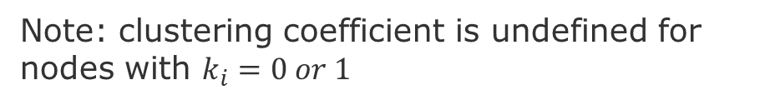
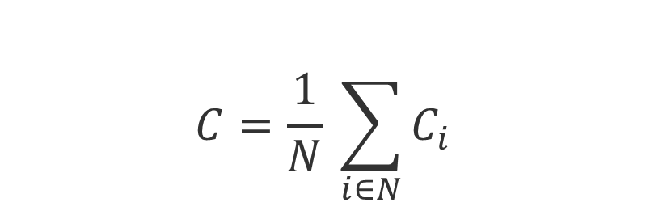

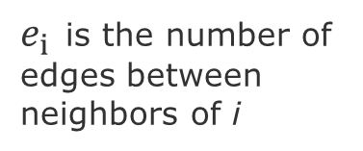
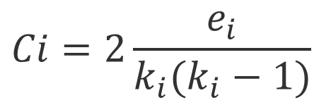
Clustering coefficient $C_{i}$
$C_{i}$Measures how many of my neighbors are connected to each other
$$C_{i}∈\left[0,1\right]$$
$$Ci=2\frac{e_{i}}{k_{i}(k_{i}−1)}$$
A
A
A
A
$e_{i }$is the number of edges between neighbors of i
B
B
B
B
C
C
C
C
D
D
D
D
$$C_{A}$$
0.0
0.3
=2*1/3*2
0.67
=2*2/3*2
1.0
=2*3/3*2
total possible edges
Note: clustering coefficient is undefined for nodes with $k_{i}=0 or 1$
Average Clustering Coefficient
$$C=\frac{1}{N} \sum_{i∈N}{C_{i}}$$
Notes:
Clustering coefficient is undefined for nodes with ki = 0 or 1

Slide 13
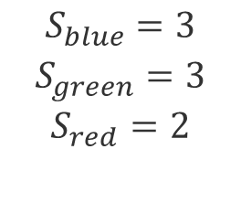
Connectivity $S$
Connectivity $S$: is the largest set of nodes that can be connected through any given path
E
A
F
B
H
C
G
D
$$S_{blue}=3$$
$$S_{green}=3$$
$$S_{red}=2$$

Slide 14
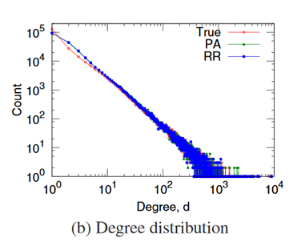
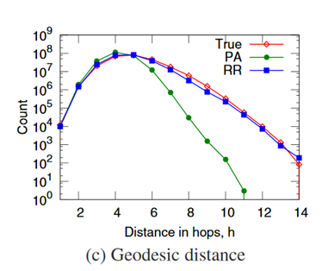
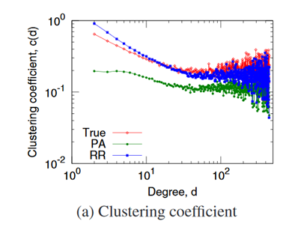

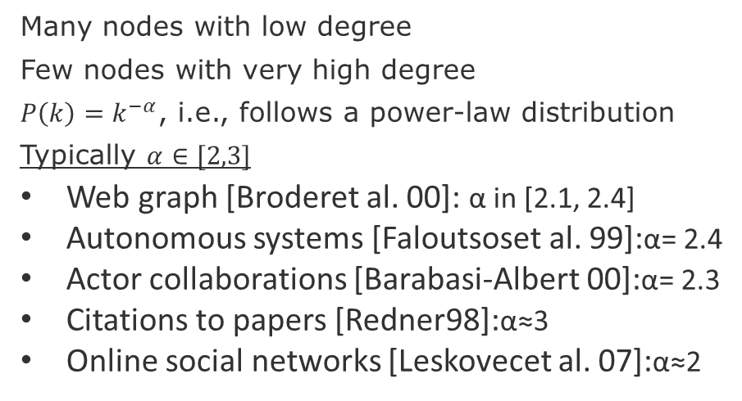
Empirical values (Flickr)
$$P\left(k\right)=k^{−α}$$
Many nodes with low degree
Few nodes with very high degree
$P\left(k\right)=k^{−α}$, i.e., follows a power-law distribution
Typically $α∈[2,3]$
Web graph [Broderet al. 00]: α in [2.1, 2.4]
Autonomous systems [Faloutsoset al. 99]:α= 2.4
Actor collaborations [Barabasi-Albert 00]:α= 2.3
Citations to papers [Redner98]:α≈3
Online social networks [Leskovecet al. 07]:α≈2
Few hops on average allow to reach anywhere in the network
Low degree nodes tend to have higher clustering
Note: remember to plot degree distributions and clustering coefficients in log-log scale
Source: Leskovec, Jure, et al. "Microscopic evolution of social networks." Proceedings of the 14th ACM SIGKDD 2008.

Slide 15
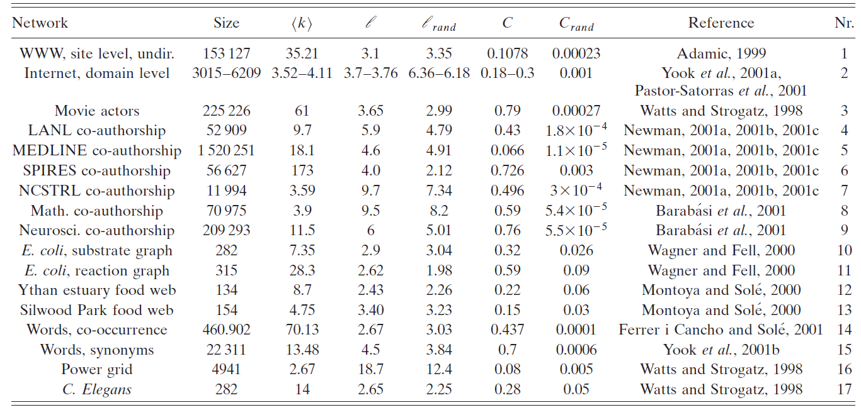
Comparing some networks
Average Clustering coefficient
Average degree
Network diameter
Source:
Albert, R., & Barabási, A. L. (2002). Statistical mechanics of complex networks. Reviews of modern physics, 74(1), 47.

Slide 16
Other ways of comparing networks
Known Node Correspondence Methods:
Difference of the adjacency matrices
DeltaCon (similarity between node pairs)
Cut distance
Unknown Node Correspondence Methods:
global statistics,
matching of subgraphs (graphlets)
Relative Graphlets Frequency Distance (RGFD)
Graphlet Degree Distribution Agreement (GDDA)
alignment-based methods entropy measures (isomorphism)
spectral methods (distance-based)
Source: Tantardini, M., Ieva, F., Tajoli, L., & Piccardi, C. (2019). Comparing methods for comparing networks. Scientific reports, 9(1), 1-19.

Slide 17
Null Models

Slide 18
Motivation
We need null-models to compare our graph metrics in a principle and reproducible manner
Obtain a real network
Generate a synthetic network
Compare networks
Null-models are generate by synthetic graph generation procedures.
Random Graph Model
Small-World Model
Kronecker Graph Model

Slide 19
Threats to validity
Construct validity: measurements might not be correct
Conclusion validity: instruments or methods adopted are not adequate
Internal validity: relations of cause-effect might not be true
External validity: results do not generalize to slight changes in the data or context.
Recommended readings:
Siegmund, J., Siegmund, N., & Apel, S. (2015, May). Views on internal and external validity in empirical software engineering. In Proceedings of the 37th International Conference on Software Engineering-Volume 1 (pp. 9-19). IEEE Press.
Wieringa, R. J. (2014). Design science methodology for information systems and software engineering. Springer.
Wohlin, C., Runeson, P., Höst, M., Ohlsson, M. C., Regnell, B., & Wesslén, A. (2012). Experimentation in software engineering. Springer Science & Business Media.

Slide 20
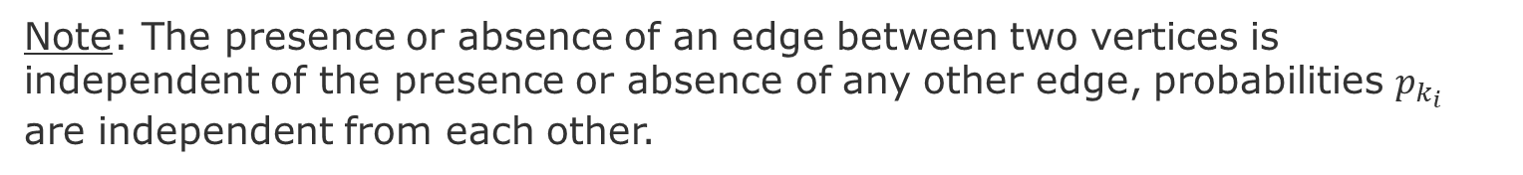
Random Graph - Erdös-Rényi (ER) networks
Stochastically connect nodes
E
E
E
A
A
A
F
F
F
B
H
B
H
B
H
C
G
C
G
C
D
D
G
D
Procedure:
For each pair of nodes decide do connect them with a probability $p_{k}$
Note: The presence or absence of an edge between two vertices is independent of the presence or absence of any other edge, probabilities $p_{k_{i}}$ are independent from each other.
Source: Newman, Mark EJ, Steven H. Strogatz, and Duncan J. Watts. "Random graphs with arbitrary degree distributions and their applications." Physical review E 64.2 (2001): 026118.

Slide 21
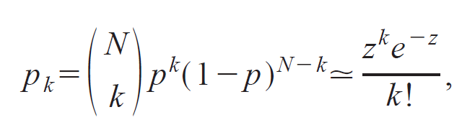
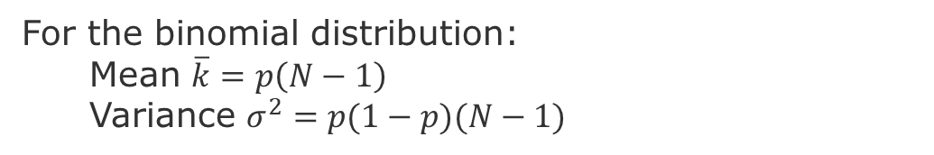
Random Graph – Distribution of Node Degree
Distribution of Node Degrees
z = average number of edges
k = degree of an edge
In the limit when N is very large. i.e., a Poisson distribution
For the binomial distribution:
Mean $\overline{k}=p\left(N−1\right)$
Variance $σ^{2}=p(1−p)(N−1)$
Newman, Mark EJ, Steven H. Strogatz, and Duncan J. Watts. "Random graphs with arbitrary degree distributions and their applications." Physical review E 64.2 (2001): 026118.
Notes:
Poisson Distribution = probability of a given number of events occurring in a fixed interval of time or space if these events occur with a known constant mean rate and independently of the time since the last event

Slide 22
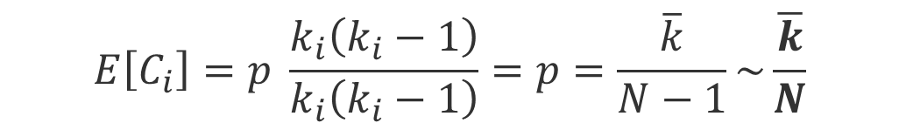

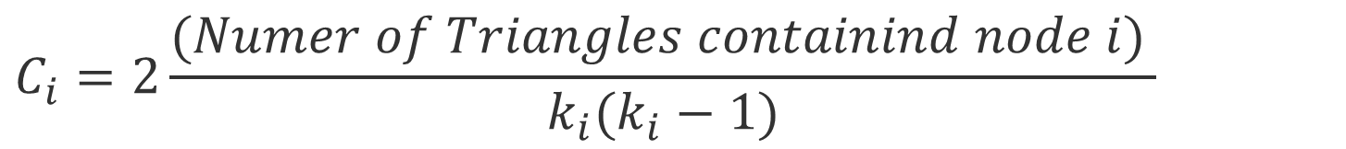
Random Graph – Clustering coefficient
Clustering coefficient:
$$C_{i}=2\frac{{(Numer of Triangles containind node i)}_{ }}{k_{i}(k_{i}−1)}$$
$$E\left[e\right]=p \frac{k_{i}(k_{i}−1)}{2}$$
Expected local clustering coefficient = p
$$E\left[C_{i}\right]=p \frac{k_{i}\left(k_{i}−1\right)}{k_{i}\left(k_{i}−1\right)}=p=\frac{\overline{k}}{N−1}\sim \frac{\overline{k}}{N}$$
This means that the clustering coefficient of a random graph is small.
Because as we generate bigger random graphs with a fixed average degree k, i.e., we set 𝑝=𝑘⋅1/N), C will decrease with the graph size N
Notes:
To derive this formula see

Slide 23
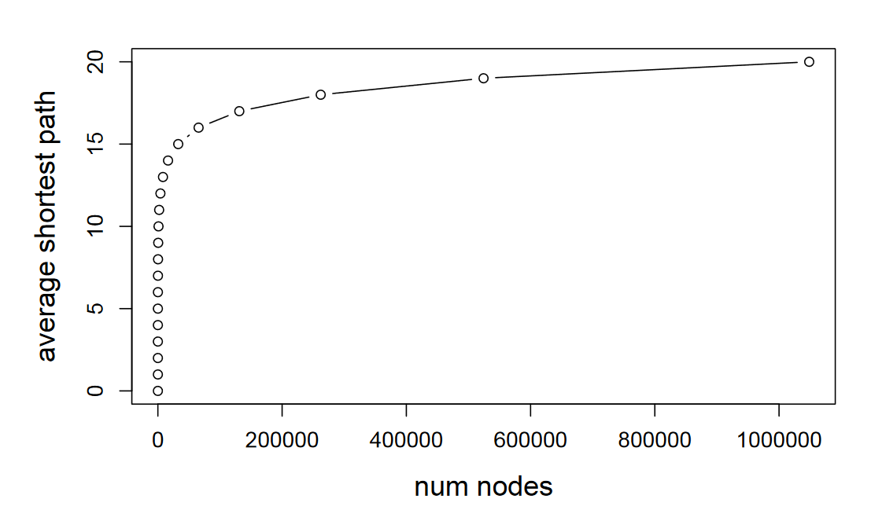
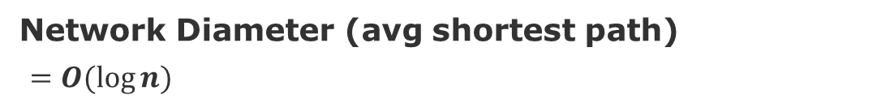
Random Graph – Network Diameter
Network Diameter (avg shortest path)
$=O(log⁡n)$
[Leskovec 2019]
Average degree constant
Notes:
[Leskovec 2019] http://web.stanford.edu/class/cs224w/slides/02-gnp-smallworld.pdf

Slide 24
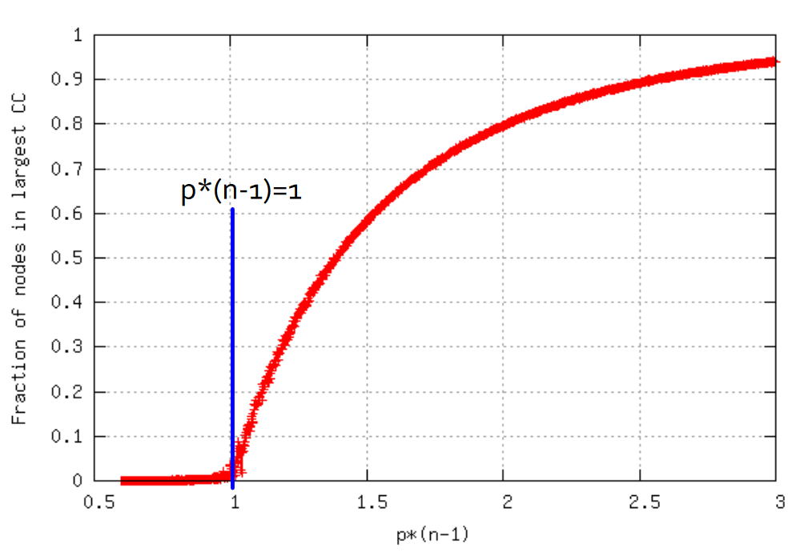
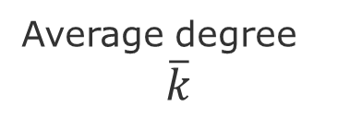
Random Graph – Connectivity
Tend to have giant components
Everything gets connected.
Disconnected graph
Fully connected graph
Average degree
$$\overline{k}$$

Slide 25
Again - Comparing some networks
Average Clustering coefficient
Average degree
Network diameter
Actors
Power grid
C. elegans
Source:
Albert, R., & Barabási, A. L. (2002). Statistical mechanics of complex networks. Reviews of modern physics, 74(1), 47.

Slide 26
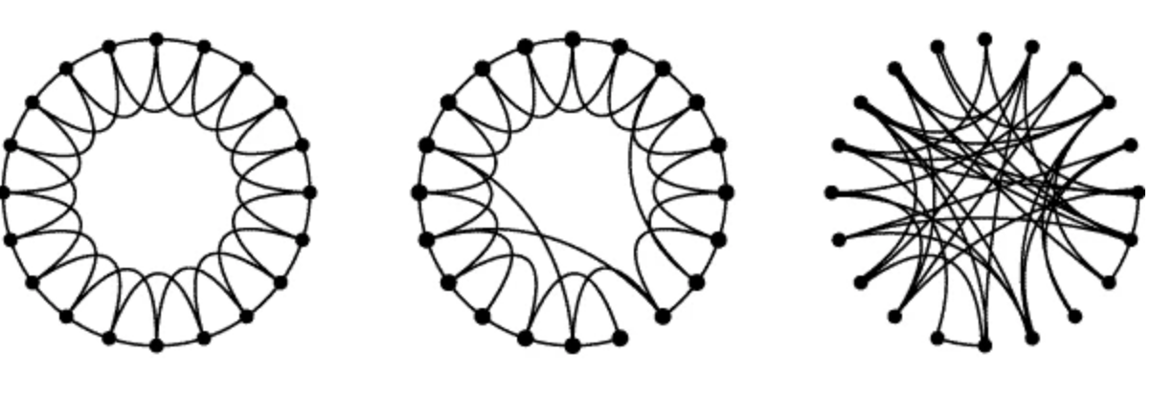
Small-World Model = high clustering + short paths
Regular
Small-World
Random
Note:
Clustering implies edge “locality”
Randomness enables “shortcuts
p =0
p=1
p = probability of reconnecting uniformly
Clustering
Diameter
High
High
High
Low
Low
Low
Procedure:
start with a ring of n vertices, each connected to its k-nearest neighbors by undirected edges.
choose a node and the edge that connects it to its nearest neighbor in a clockwise.
reconnect with probability p this edge to a node chosen uniformly over the entire ring
Source: Watts, Duncan J., and Steven H. Strogatz. "Collective dynamics of ‘small-world’networks." nature 393.6684 (1998): 440-442.
Notes:
Procedure: start with a ring of n vertices, each connected to its k nearest neighbors by undirected edges.
We choose a node and the edge that connects it to its nearest neighbor in a clockwise sense. With probability p, we reconnect this edge to a vertex chosen uniformly at random over the entire ring.

Slide 27
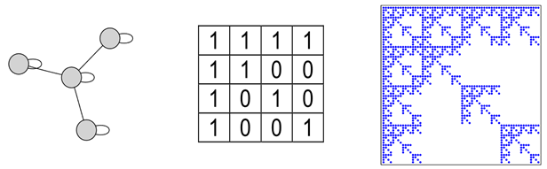
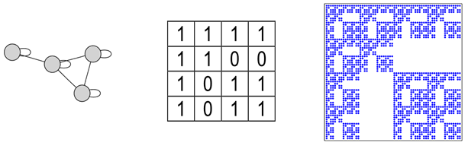
Kronecker Model
Small-World model captures the structure of many realistic networks
However, it does not produce the correct degree distribution
Solution: use the idea do self-similarity (the whole is in the parts)
Code to generate: https://github.com/BenjaminDHorne/Stochastic-Kronecker-Generator
Source: Leskovec, Jure, et al. "Kronecker graphs: an approach to modeling networks." Journal of Machine Learning Research 11.2 (2010).

Slide 28
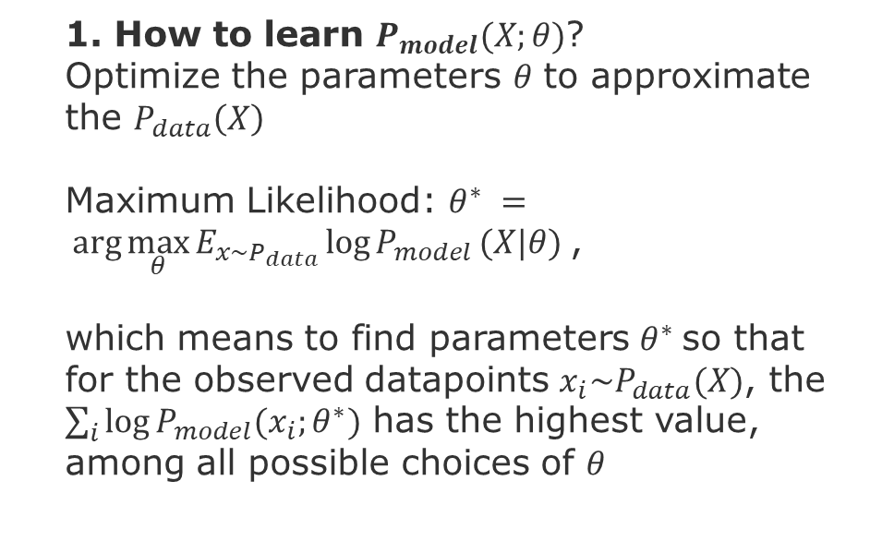
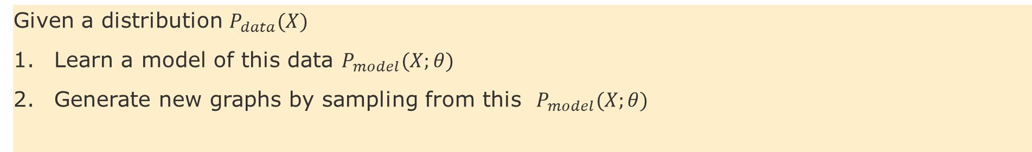
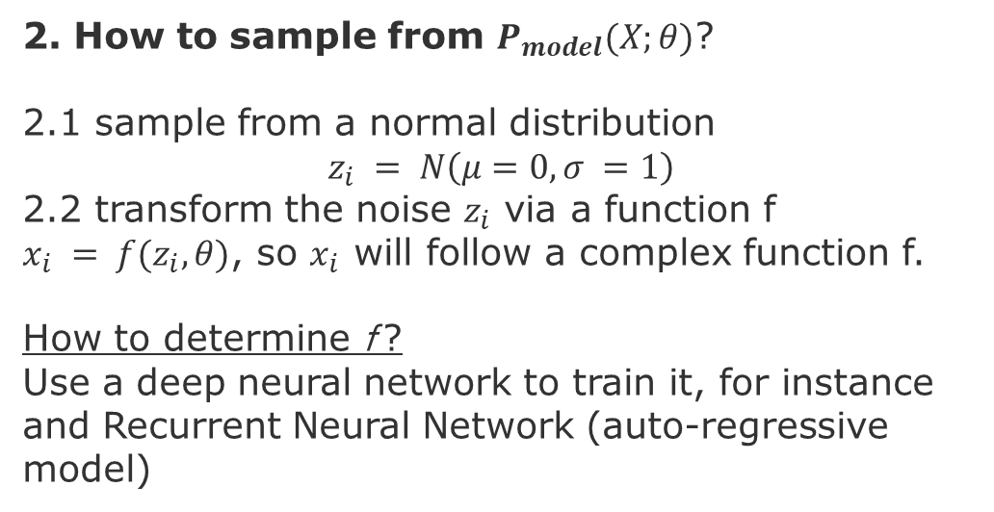
Deep Generative Models
Given a distribution $P_{data}(X)$
Learn a model of this data $P_{model}(X;θ)$
Generate new graphs by sampling from this $P_{model}(X;θ)$
1. How to learn $P_{model}(X;θ)$?
Optimize the parameters $θ$ to approximate the $P_{data}\left(X\right)$
Maximum Likelihood: $θ^{∗} = arg\max_{θ}{E_{x\sim P_{data}}\log{P_{model}}(X|θ)}$,
which means to find parameters $θ^{∗}$so that for the observed datapoints $x_{i}\sim P_{data}(X)$, the $\sum_{i}{\log{P_{model}(x_{i};θ^{∗})}}$ has the highest value, among all possible choices of $θ$
2. How to sample from $P_{model}(X;θ)$?
2.1 sample from a normal distribution
$$z_{i} = N\left(μ=0,σ =1\right)$$
2.2 transform the noise $z_{i}$ via a function f
$x_{i} = f(z_{i},θ)$, so $x_{i}$ will follow a complex function f.
How to determine f ?
Use a deep neural network to train it, for instance and Recurrent Neural Network (auto-regressive model)

Slide 29
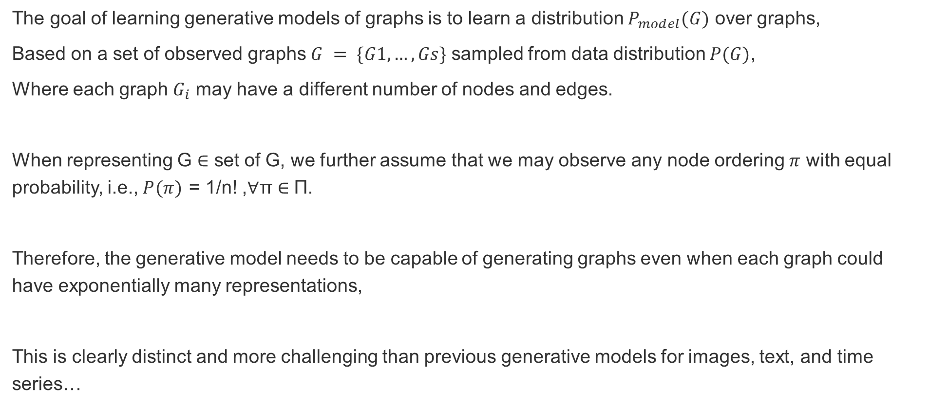
Deep Generative Models - Challenge
The goal of learning generative models of graphs is to learn a distribution $P_{model}(G)$ over graphs,
Based on a set of observed graphs $G = \{G1,…,Gs\}$ sampled from data distribution $P(G)$,
Where each graph $G_{i}$ may have a different number of nodes and edges.
When representing G ∈ set of G, we further assume that we may observe any node ordering $π$ with equal probability, i.e., $P(π)$ = 1/n! ,∀π ∈ Π.
Therefore, the generative model needs to be capable of generating graphs even when each graph could have exponentially many representations,
This is clearly distinct and more challenging than previous generative models for images, text, and time series…

Slide 30
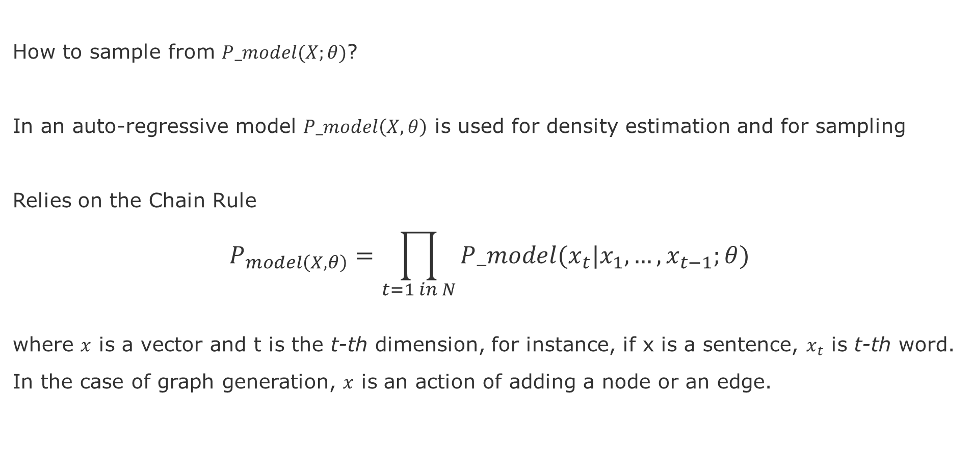
Deep Generative Model
How to sample from $P_model(X;θ)$?
In an auto-regressive model $P_model\left(X,θ\right)$ is used for density estimation and for sampling
Relies on the Chain Rule
$$P_{model\left(X,θ\right)}=\prod_{t=1 in N}{P_model(x_{t}|x_{1},…,x_{t−1};θ) }$$
where $x$ is a vector and t is the t-th dimension, for instance, if x is a sentence, $x_{t}$ is t-th word.
In the case of graph generation, $x$ is an action of adding a node or an edge.

Slide 31
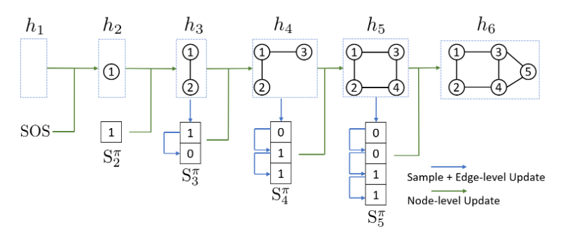


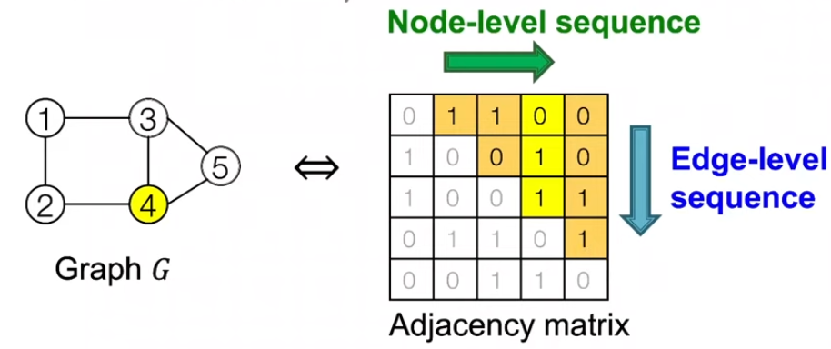
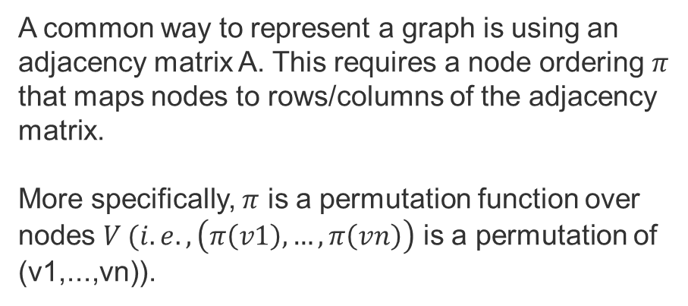
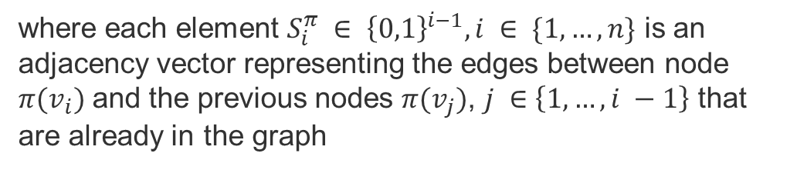
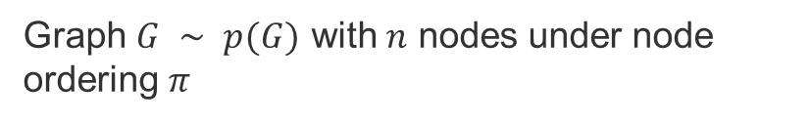
Graph RNN [You et al. 2018]
Graph $G ∼ p(G)$ with $n$ nodes under node ordering $π$
Graph Sequence definition:
where each element $S_{i}^{π} ∈ {\left\{0,1\right\}}^{i−1},i ∈ \{1,…,n\}$ is an adjacency vector representing the edges between node $π(v_{i})$ and the previous nodes $π(v_{j})$, $j ∈\left\{1,…,i −1\right\}$ that are already in the graph
A common way to represent a graph is using an adjacency matrix A. This requires a node ordering $π$ that maps nodes to rows/columns of the adjacency matrix.
More specifically, $π$ is a permutation function over nodes $V (i.e., \left(π\left(v1\right),…,π\left(vn\right)\right)$ is a permutation of (v1,...,vn)).
Adjacency matrices
Sources:
You, J., et al., 2018, GraphRNN: Generating Realistic Graphs with Deep Auto-regressive Models, in proc. of the 35th International Conference on Machine Learning
Jures Leskovec, slides CS224W: Machine Learning with Graphs | 2021 | Lecture 15.2

Slide 32
Suggested Task
Browse over a few datasets that have spatio-temporal information
Try one or two examples using Snap or NetworkX
Look at how networks compare w.r.t. metrics, do you see something surprising?

Slide 33
END

